Slide 1
Numerical Investigation towards a Mechanistic Approach for Prediction of Two-Phase Bubbly Flow with and without Heat and Mass Transfer
Sara Vahaji
First Supervisor: Prof. Jiyuan Tu
Second Supervisor: Dr. Sherman Chi Pok Cheung
Notes:
Information to help you understand how the committees work and help you act as a student member.

Slide 2
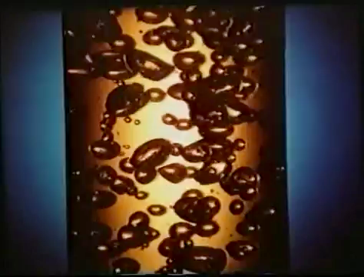
Two-phase Bubbly Flow
Source: http://www.youtube.com/watch?v=NXz2CuM2ZZM

Slide 3
Contents
Introduction
Two-phase bubbly flow without heat and mass transfer
Numerical modelling
Case study: bubbly flow over flat plate
Two-phase bubbly flow with heat and mass transfer
Numerical modelling
Case study I : subcooled boiling at low pressure
Case study II: subcooled boiling at elevated pressure
Conclusion and future work

Slide 4
Problem Definition

Slide 5
Transportation Pipelines
Pipelines subjected to long distances
Mineral Processing Pipelines
Agitate
Mix
Effective use of transport momentum
Bubbles generated by
Gas injection
Electrolysis

Slide 6

Application (Safety analysis)
Source: http://www.youtube.com/watch?v=4bvCDheLm5A
Mass Flow

Slide 7
Two-phase bubbly flow
without
heat and mass transfer

Slide 8
Two-fluid Model and Closure terms
Two-fluid model: the most practical macroscopic formulation
Closure terms
Turbulent viscosity
Interfacial Force
Interfacial area concentration
Turbulent Model
Drag Force and Non-drag Force
Population Balance Model

Slide 9
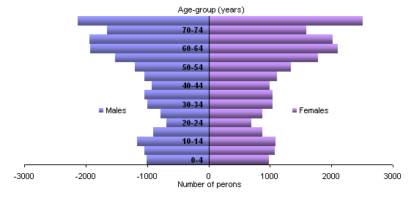
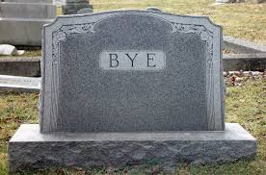
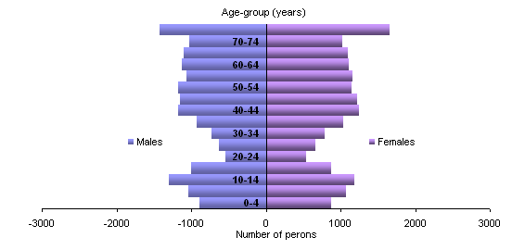
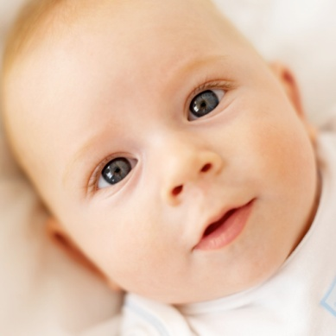
What is Population balance?
Ten Years later
Birth rate
Death rate

Slide 10
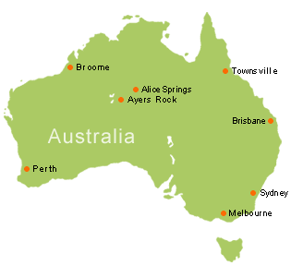
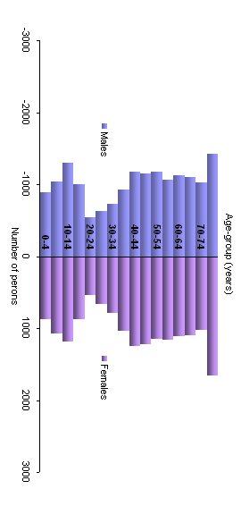
Bubble Size Distribution (BSD)
Number of bubble
Number of person
Population Distribution
BSD Function
Bubble Size
Age

Slide 11
Bubble Size Distribution (BSD) Equation
N(n_{i})
n_{i}’
n’
n_{i}’
n_{i}’
n_{i}’
n_{i}
P_{B}
n_{i}
D_{B}
n_{i}
n_{i}
n_{i}
n_{i}
n_{i}
n_{i}
N(n_{i})
P_{C}
n_{i}
D_{C}
n_{i}
n_{i}
Fluid Velocity
if
else

Slide 12
MUltiple SIze Group (MUSIG) Model
Used N size group (scalar) to describe bubble population
N extra equations have to be solved (depends on number of group used)
Advantage:
Higher resolution for bubble classes
Disadvantage:
Higher computational complexity

Slide 13
Bubble Coalescence and Breakage
Bubbles may “merge” together forming larger bubbles
Coalescence reduces number of bubbles but increases size of bubbles
Bubbles may break-up due to turbulence impact
Breakage increases number of bubbles but decrease size of bubbles
N(D_{p})
N(D_{p})
D_{p}
D_{p}

Slide 14
Coalescence Mechanism
Coalescence due to random collisions driven by turbulence
Merge
Bounce

Slide 15
Research gap:
Influence of different coalescence kernels on BSD
Research questions:
What is the influence of different coalescence kernels on predicting BSD?

Slide 16
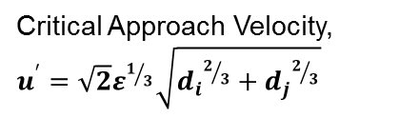
Selected coalescence models
Coalescence kernels:
Coulaloglou and Tavlarides (1977)- Film drainage model, immobile surface
Prince and Blanch (1990)-Film drainage model, mobile surface
Lehr et al. (2002)-critical velocity model
d_{i}
d_{j}
Merge
ε
Immobile surfaces
h
Bounce
Critical thickness
Film drainage model
Mobile surfaces

Slide 17
Computational Geometry
Exp. By Merkle and Deutch
Case | Air flow rate Q_{a} (m³/s) | Re_{L} based on the total plate length
Q0-V9.6(C_{fo}) | 0 | 7.66 x 10⁶
Q1-V9.6 | 0.001 | 7.66 x 10⁶
Q2-V9.6 | 0.0015 | 7.66 x 10⁶
Q3-V9.6 | 0.002 | 7.66 x 10⁶
Q4-V9.6 | 0.0025 | 7.66 x 10⁶
Fig 1- S. Vahaji, L. Chen, S.C.P. Cheung and J.Y. Tu, Modelling of Two-Phase Bubbly Flow over a Flat Plate, 19th Australasian Fluid Mechanics Conference, Melbourne, Australia, Paper No. 55 (Dec. 2014).

Slide 18
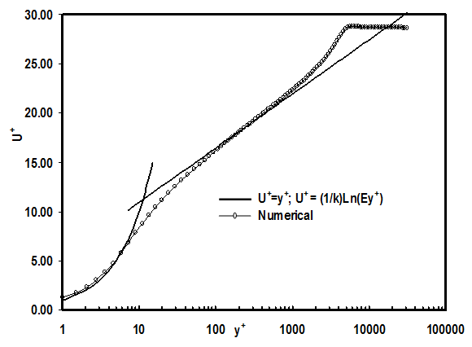
Boundary Layer Resolution
Fig 2- K. Mohanarangam, S.C.P.Cheung, J.Y. Tu, L.Chen, Numerical simulation of micro-bubble drag reduction using population
balance model, Ocean Engineering Journal, Vol(36), pp. 863–872 (2009).

Slide 19
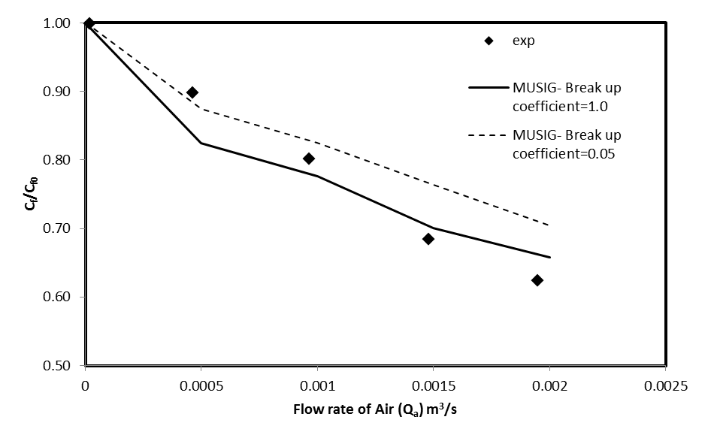
Skin-Friction Validation
Q_{a}
Cf/Cf0
Fig 2- S. Vahaji, L. Chen, S.C.P. Cheung and J.Y. Tu, Modelling of Two-Phase Bubbly Flow over a Flat Plate, 19th Australasian Fluid Mechanics Conference, Melbourne, Australia, Paper No. 55 (Dec. 2014).

Slide 20
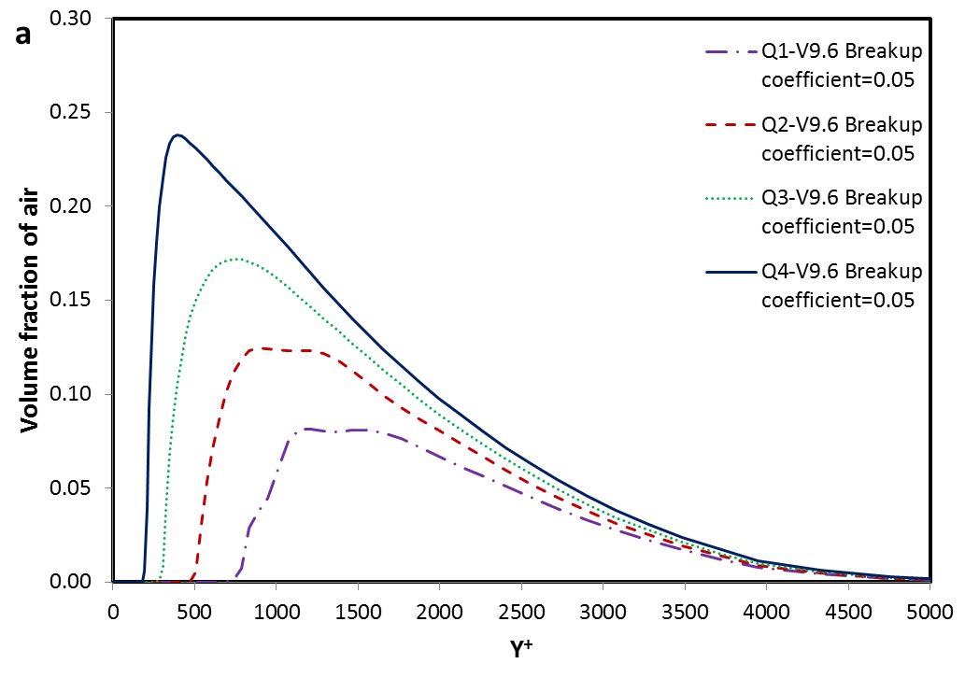
Volume Fraction of Air
Fig 3-a- S. Vahaji, L. Chen, S.C.P. Cheung and J.Y. Tu, Modelling of Two-Phase Bubbly Flow over a Flat Plate, 19th Australasian Fluid Mechanics Conference, Melbourne, Australia, Paper No. 55 (Dec. 2014).

Slide 21
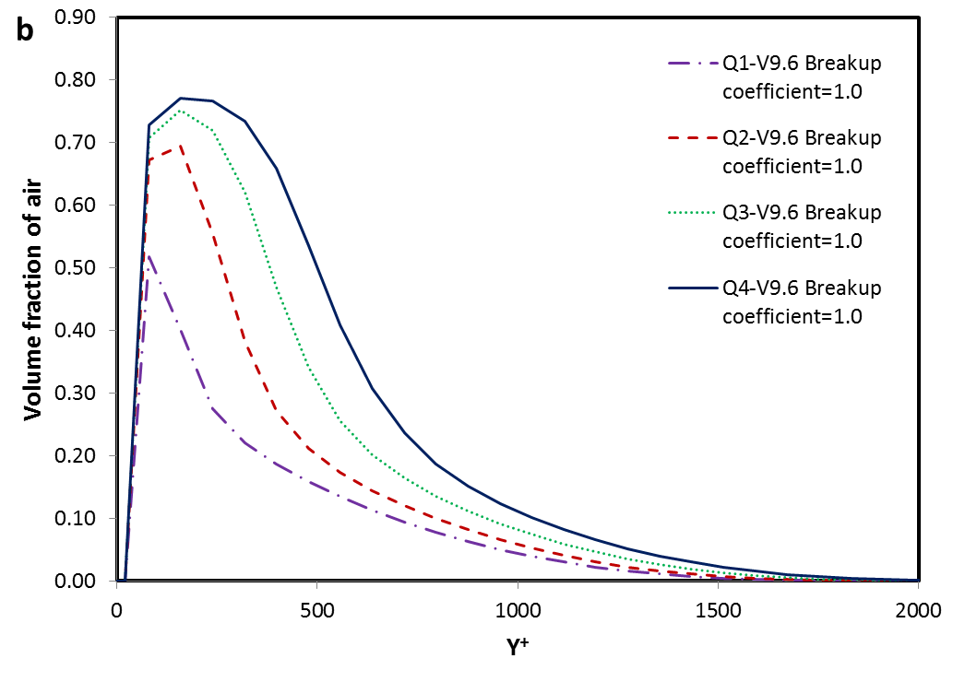
Volume Fraction of Air
Fig 3-b- S. Vahaji, L. Chen, S.C.P. Cheung and J.Y. Tu, Modelling of Two-Phase Bubbly Flow over a Flat Plate, 19th Australasian Fluid Mechanics Conference, Melbourne, Australia, Paper No. 55 (Dec. 2014).

Slide 22
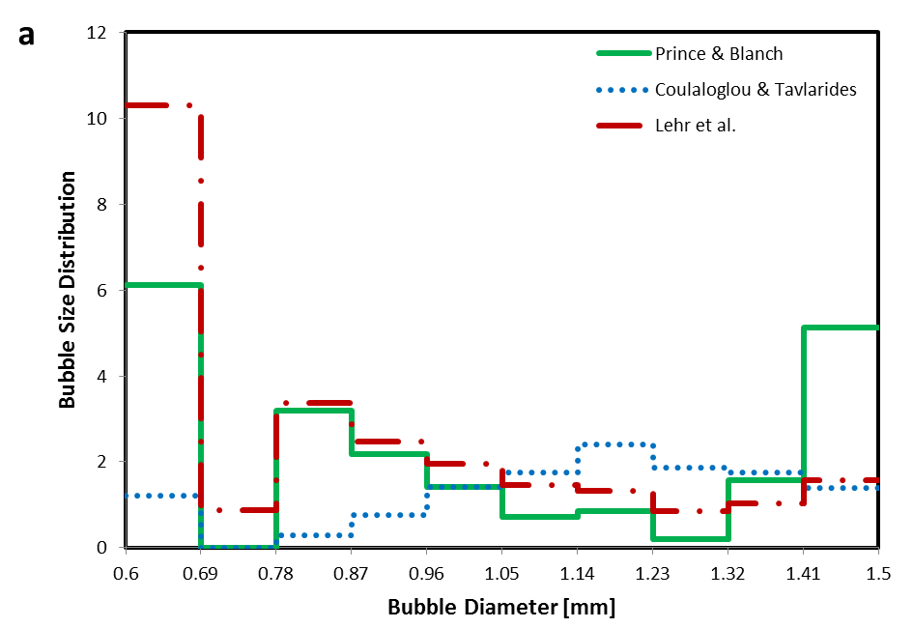
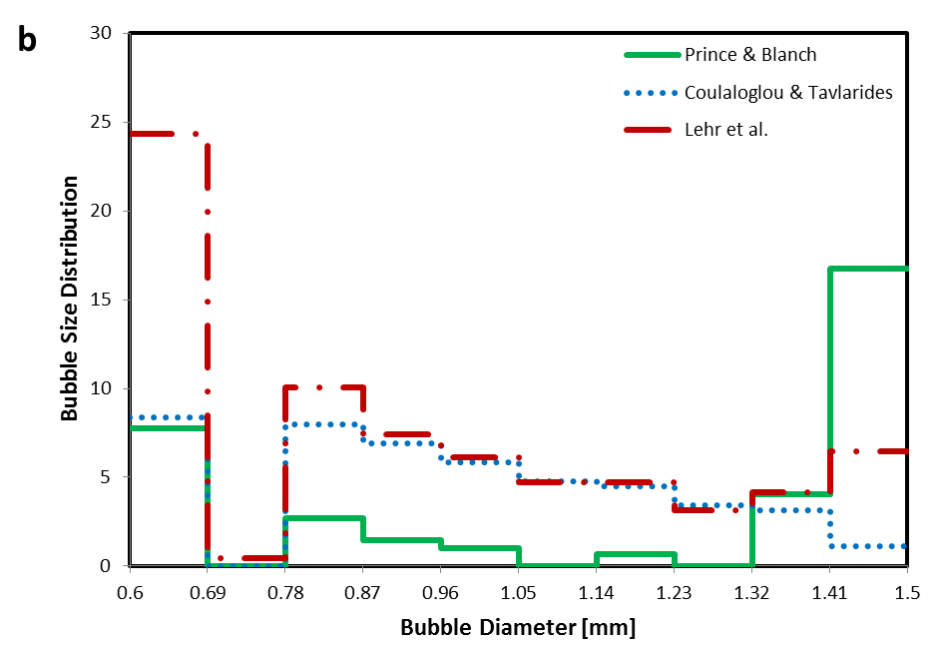
Bubble Size Distribution
Case Q1-V9.6
Q_{a}
Bubble size
Case Q3-V9.6
Fig 5-a- S. Vahaji, L. Chen, S.C.P. Cheung and J.Y. Tu, Modelling of Two-Phase Bubbly Flow over a Flat Plate, 19th Australasian Fluid Mechanics Conference, Melbourne, Australia, Paper No. 55 (Dec. 2014).

Slide 23
Without heat and mass transfer: Conclusion and recommendation
Bubbly flow over flat plate successfully simulated using MUSIG model
Influence of different coalescence kernels investigated
It is recommended to test the performance of the model on a real life application (e.g. bubble injection around the body of a ship)

Slide 24
Two-phase bubbly flow
with
heat and mass transfer

Slide 25
Phenomenological Description
Subcooled boiling flows are by nature a complex boiling process
Heated walls
Distorted/Cap bubbles
Bubble nucleation
(with sliding)
Void Fraction
Break-up
Subcooled Boiling
Single Phase
Highly Subcooled
Slightly Subcooled
Coalescence
Condensation
ONB
NVG
Height
Bubble nucleation
Subcooled liquid flows

Slide 26
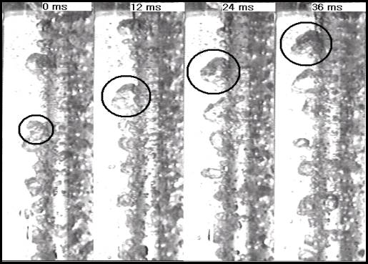
Phenomenological Observation
Bubbles undergoining condensation in the bulk subcooled liquid
Bubbles merging in the bulk subcooled liquid
Bubbles sliding along the heated wall
Experimental observation by Gopinath et al., 2002
Experimental observation by Lee et al., 2002

Slide 27

Bubble growth, departure, sliding and lift off
Bubble Growth
Bubble Frequency
Bubble Sliding
Bubble Condensation

Slide 28

Bubble nucleation
Source: http://www.slis.tsukuba.ac.jp/~fujisawa.makoto.fu/avi/boiling.mp4

Slide 29
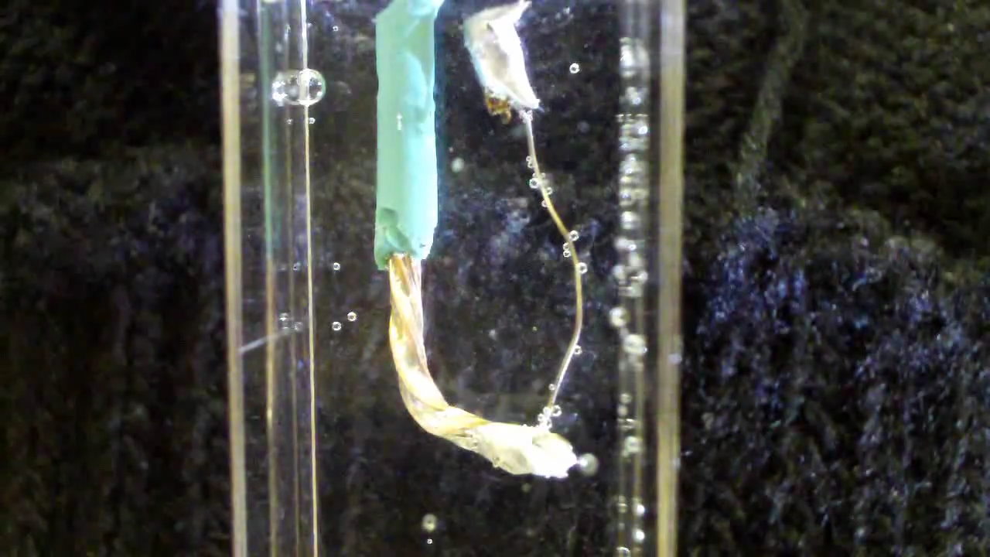
Bubble nucleation
Source: http://www.youtube.com/watch?v=p2NE6o530ak

Slide 30
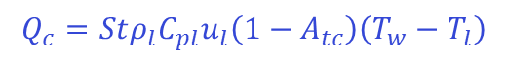
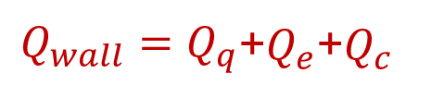
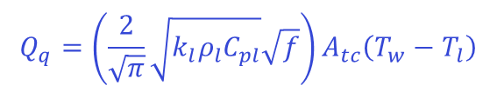
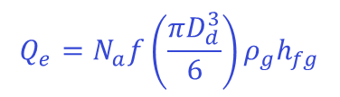
Wall Heat Flux Partition Model
Wall heat flux is divided into three components
$Q_{wall}=Q_{q}$+$Q_{e}$+$Q_{c}$
Convection
$$Q_{c}=Stρ_{l}C_{pl}u_{l}\left(1−A_{tc}\right)\left(T_{w}−T_{l}\right)$$
$$Q_{e}=N_{a}f\left(\frac{πD_{d}^{3}}{6}\right)ρ_{g}h_{fg}$$
Evaporation
Quenching (conduction)
$$Q_{q}=\left(\frac{2}{\sqrt{π}}\sqrt{k_{l}ρ_{l}C_{pl}}\sqrt{f}\right)A_{tc}\left(T_{w}−T_{l}\right)$$
Wall heat flux
Important parameters
Departing Bubble size
Bubble frequency
Active nucleation site density

Slide 31
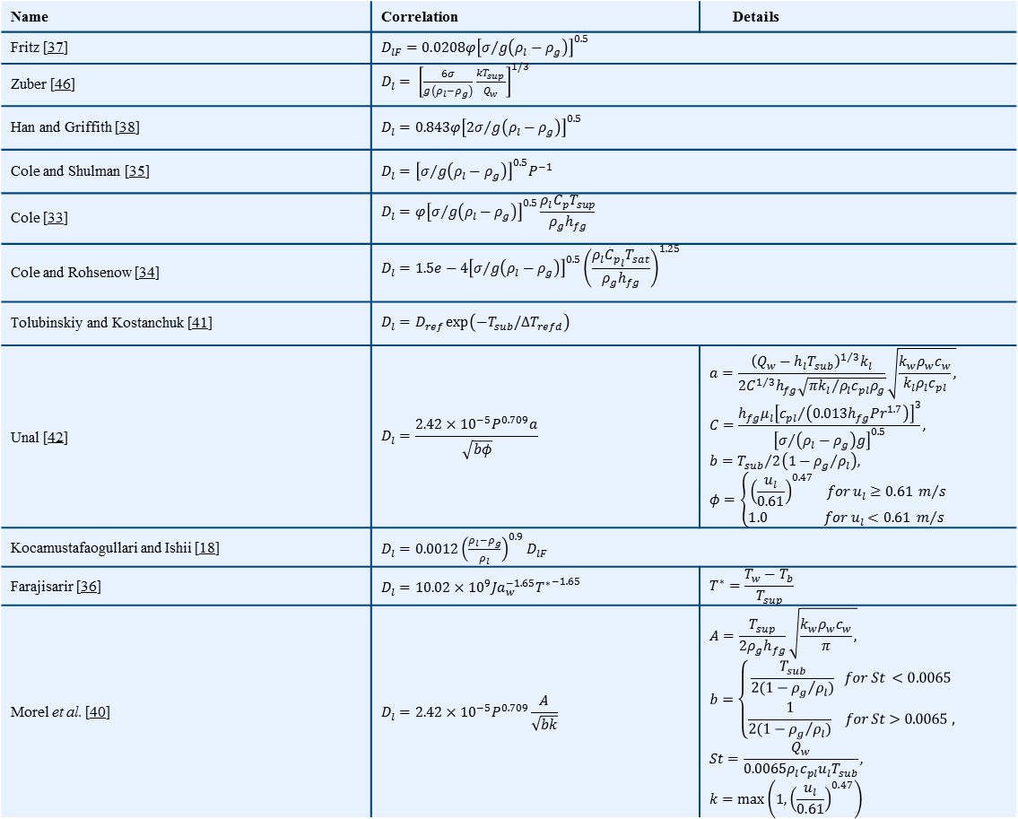
Empirical correlations for bubble departure diameter
Name | Correlation | Details
Fritz [37]
Zuber [46]
Han and Griffith [38]
Cole and Shulman [35]
Cole [33]
Cole and Rohsenow [34]
Tolubinskiy and Kostanchuk [41]
Unal [42]
Kocamustafaogullari and Ishii [18]
Farajisarir [36]
Morel et al. [40]
Table 2- S.C.P. Cheung, S. Vahaji, G.H. Yeoh and J.Y. Tu, Modelling Subcooled Flow Boiling in Vertical Channels at Low Pressures - Part 1: Assessment of empirical correlations, International Journal of Heat and Mass Transfer, Vol(75), pp. 736-753 (2014). Journal Rank: A*

Slide 32
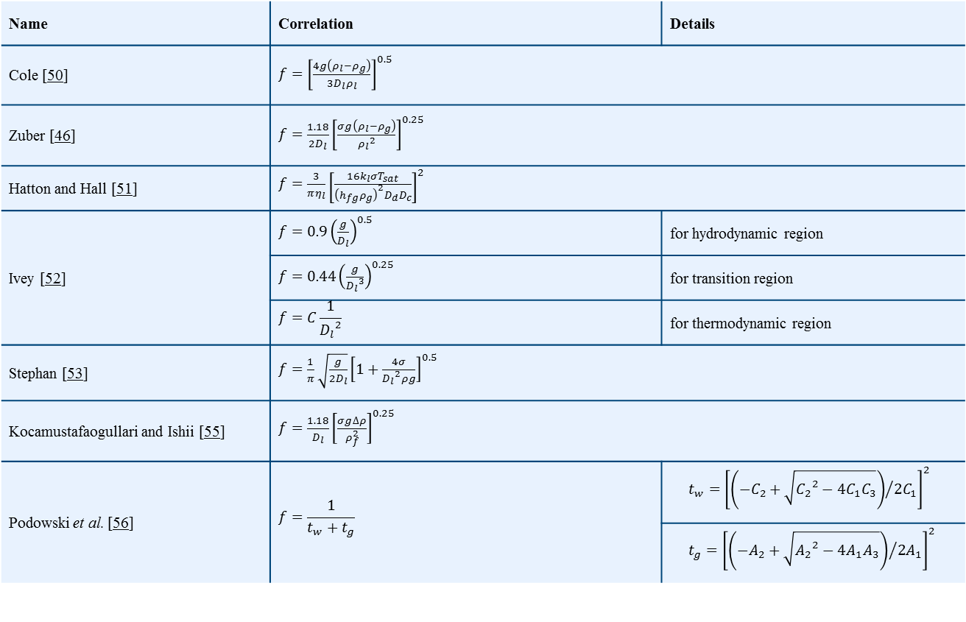
Empirical correlations for bubble frequency
Name | Correlation | Details
Cole [50]
Zuber [46]
Hatton and Hall [51]
Ivey [52] |  | for hydrodynamic region
 |  | for transition region
 |  | for thermodynamic region
Stephan [53]
Kocamustafaogullari and Ishii [55]
Podowski et al. [56]
Table 3- S.C.P. Cheung, S. Vahaji, G.H. Yeoh and J.Y. Tu, Modelling Subcooled Flow Boiling in Vertical Channels at Low Pressures - Part 1: Assessment of empirical correlations, International Journal of Heat and Mass Transfer, Vol(75), pp. 736-753 (2014). Journal Rank: A*

Slide 33
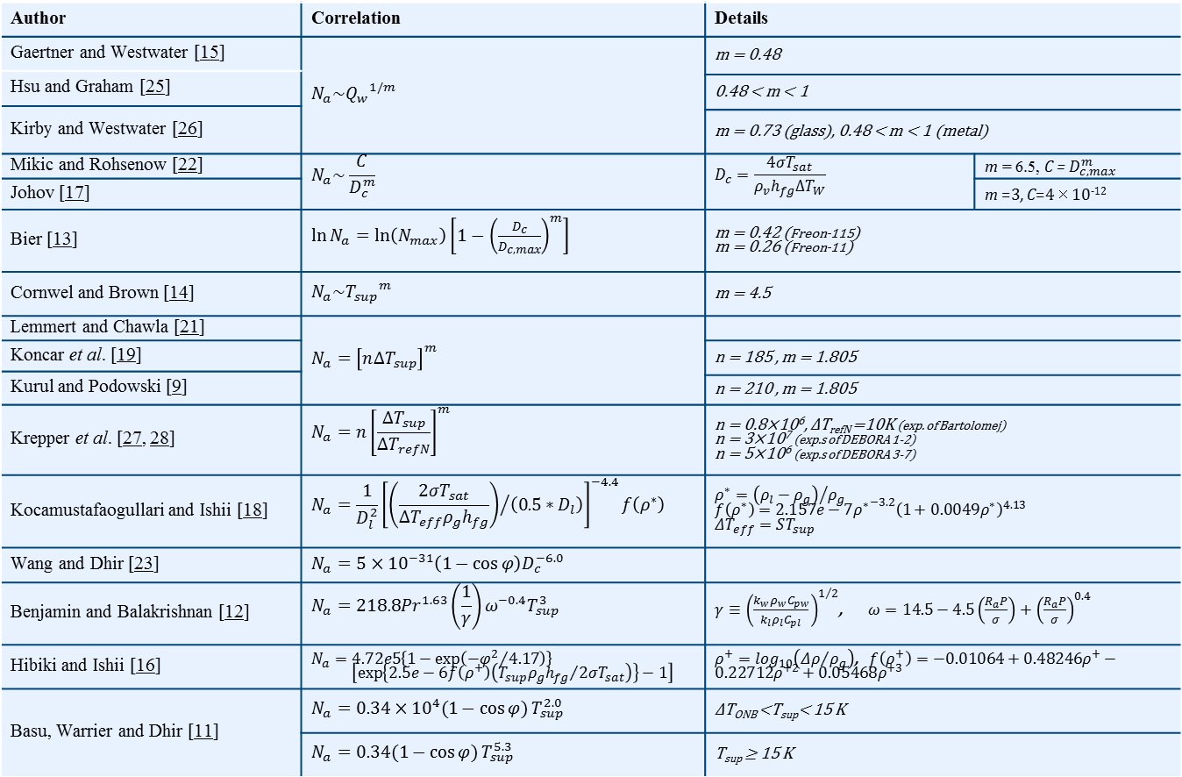
Empirical correlations for active nucleation site density
Author | Correlation | Details
Gaertner and Westwater [15] |  | m = 0.48
Hsu and Graham [25]
 |  | 0.48 < m < 1
Kirby and Westwater [26]
 |  | m = 0.73 (glass), 0.48 < m < 1 (metal)
Mikic and Rohsenow [22]
 |  |  | m =3, C=4×10⁻¹²
Johov [17]
Bier [13] |  | m = 0.42 (Freon-115) m = 0.26 (Freon-11)
Cornwel and Brown [14] |  | m = 4.5
Lemmert and Chawla [21] |  | n = 185 , m = 1.805
Koncar et al. [19] |  | n = 210 , m = 1.805
Kurul and Podowski [9]
Krepper et al. [27, 28] |  | n = 0.8×10⁶, ΔT_{refN} =10K (exp. of Bartolomej) n = 3×10⁷ (exp.s of DEBORA 1-2) n = 5×10⁶ (exp.s of DEBORA 3-7)
Kocamustafaogullari and Ishii [18]
Wang and Dhir [23]
Benjamin and Balakrishnan [12]
Hibiki and Ishii [16]
Basu, Warrier and Dhir [11] |  | ΔT_{ONB} <T_{sup}< 15 K
 |  | T_{sup} ≥ 15 K
Table 1- S.C.P. Cheung, S. Vahaji, G.H. Yeoh and J.Y. Tu, Modelling Subcooled Flow Boiling in Vertical Channels at Low Pressures - Part 1: Assessment of empirical correlations, International Journal of Heat and Mass Transfer, Vol(75), pp. 736-753 (2014). Journal Rank: A*

Slide 34
Research gap:
Highly empirical correlations for prediction of bubble dynamics (D,f,Na)
Sliding of the bubbles on the wall is not considered
Research questions:
How to adopt a more mechanistic model for prediction of bubble dynamics?
How to mechanistically predict the bubble detachment diameter,
bubble departure frequency, and
active nucleation site density?
If possible, how to couple the mechanistic models with two-fluid model?
If possible, how would it perform compared to existing empirical correlations?

Slide 35
Force Balance Model for Bubble Detachment
ΣF_{x} = F_{sx} + F_{dux} + F_{sL} + F_{h} + F_{cp}
ΣF_{y} = F_{sy} + F_{duy} + F_{qs} + F_{b}
The forces acting on the bubble are:
surface tension force (Fs)
unsteady drag force due to asymmetrical growth of the bubble (Fdu)
shear lift force (FsL)
force due to the hydrodynamic pressure (Fh)
contact pressure force accounting for the bubble being in contact with a solid (Fcp)
quasi steady-drag force in the flow direction (Fqs)
buoyancy force (Fb)
Fig 2- G.H. Yeoh et al., Fundamental consideration of wall heat partition of vertical subcooled boiling flows, Int. J. Heat Mass Transfer, Vol(51), pp. 3840–3853 (2008).

Slide 36
Force Balance Model for Bubble Detachment (con’t)
The forces acting on the bubble in the x- and y-directions are:
ΣF_{x} = F_{sx} + F_{dux} + F_{sL} + F_{h} + F_{cp}
ΣF_{y} = F_{sy} + F_{duy} + F_{qs} + F_{b}
Along the x-direction Along the y-direction
α, β and θ_{i} are the advancing, receding and inclination angles respectively; d_{w} is the surface/bubble contact diameter

Slide 37
Bubble Frequency
Growth time t_{g} is evaluated directly from the force balance model for the bubble lift-off
Waiting time t_{w} is determined according to
Cavity Radius
F indicates the degree of flooding of the available cavity size and the wettability of the surface

Slide 38
Bubble growth, sliding and lift-off
A_{tcsl}
A_{tc}
Q_{e}
Q_{tcsl}
Heated Surface
Heated Surface
Lift-off
Growth
Heated Surface
Sliding
D_{l}
Q_{e}
Q_{tc}
Q_{c}
Q_{c}
D_{sl}
Q_{c}
Fluid direction
Fluid direction
Fluid direction
Fig 1- G.H. Yeoh, S. Vahaji, S.C.P. Cheung and J.Y. Tu, Modelling Subcooled Flow Boiling in Vertical Channels at Low Pressures - Part 2: Evaluation of Mechanistic Approach, International Journal of Heat and Mass Transfer, Vol(75), pp. 754-768 (2014). Journal Rank: A*

Slide 39
Improved Wall Heat Flux Partition Model
Wall heat flux is divided into four components
Convection
Evaporation
Transient conduction due to sliding bubbles
Transient conduction due to stationary bubbles
Important parameters
Active nucleation site density
Departing Bubble size
Bubble frequency
Wall heat flux

Slide 40
Fractal Model
Formulation:
Fractal scaling law cumulative number of active cavities greater than and equal to particular cavity diameter D_{c} is given by
Fractal dimension
Maximum diameters of active cavity
Minimum diameters of active cavity
Thermal boundary layer thickness

Slide 41
Physical Modeling Considerations:
Transportation of both phases →two-fluid model
Bubble coalescence and break-up →population balance model (MUSIG)
Condensation in subcooled liquid →source term to liquid phase
Bubble departure and lift-off diameter
(Dd, Dsl, Dl)
Bubble departure frequency (f)
Active nucleation site density (Na)
Wall boundary condition;
Source term for gas phase;
Source term for energy equation

Slide 42
Case study I: subcooled boiling at low pressure
Local case
Exp. By Prof Park and colleagues
19 mm
Measuring Plane
at
1610 mm
Experimental conditions
1670 mm long Heated Section
Case | P_{inlet} [MPa] | T_{inlet} [ºC] | T_{sub} (inlet) [ºC] | Q_{w} [kW/m²] | G [kg/m²s]
L1 | 0.143 | 96.9 | 13.4 | 152.9 | 474.0
L2 | 0.137 | 94.9 | 13.8 | 197.2 | 714.4
L3 | 0.143 | 92.1 | 17.9 | 251.5 | 1059.2
Heated Inner Tube
9.25 mm
Inlet Liquid Flow

Slide 43
Case study I (cont’d)
25.4 mm
Axial case
Exp. by Zeitoun & Shoukri
12.7 mm
Experimental conditions
306 mm long Heated Section
Case | P_{inlet} [MPa] | T_{inlet} [ºC] | T_{sub} (inlet) [ºC] | Q_{w} [kW/m²] | G [kg/m²s]
A1 | 0.137 | 91.9 | 14.9 | 286.7 | 156.2
A2 | 0.122 | 93.6 | 11.6 | 286.5 | 258.2
A3 | 0.150 | 94.6 | 16.6 | 508.0 | 264.3
A4 | 0.150 | 88.9 | 22.5 | 705.0 | 411.7
Heated Inner Tube
Inlet Liquid Flow

Slide 44
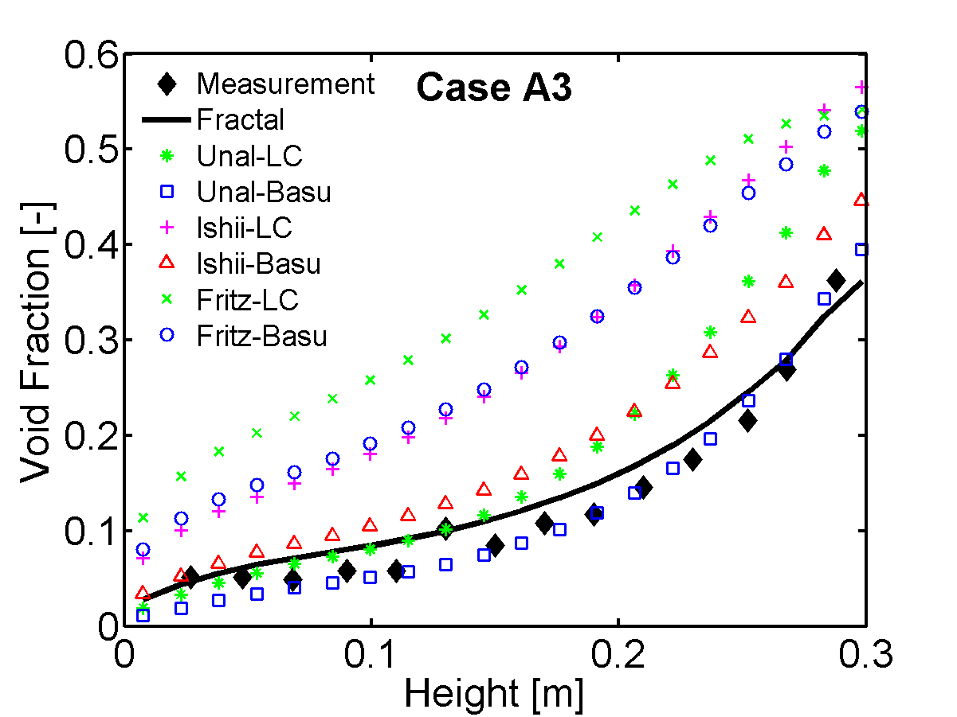
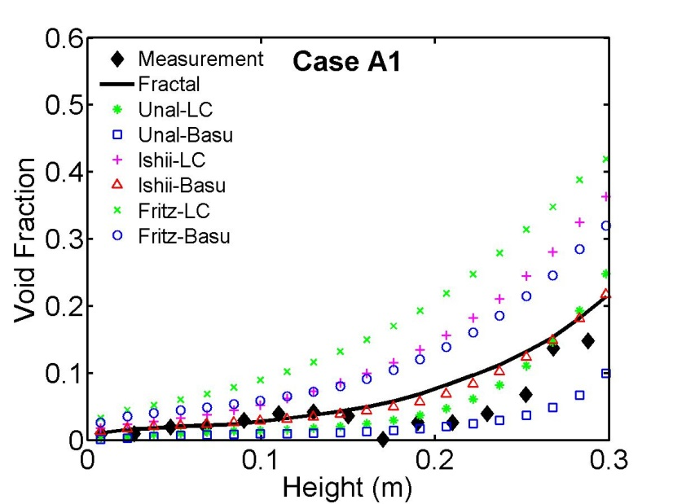
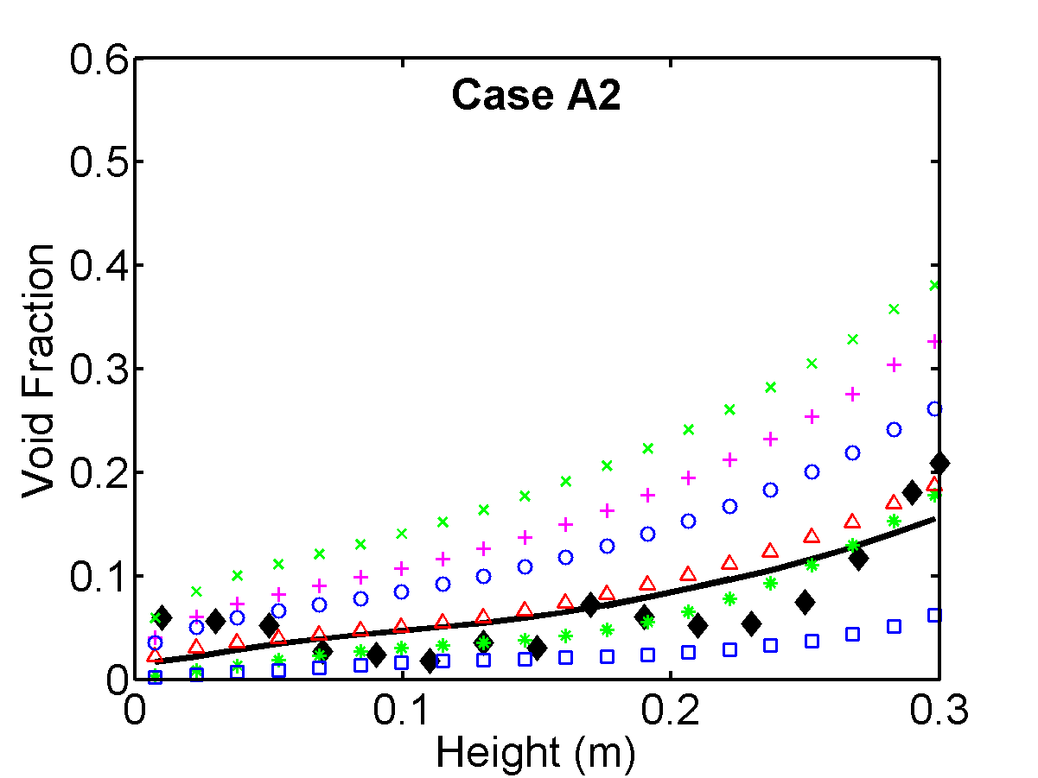
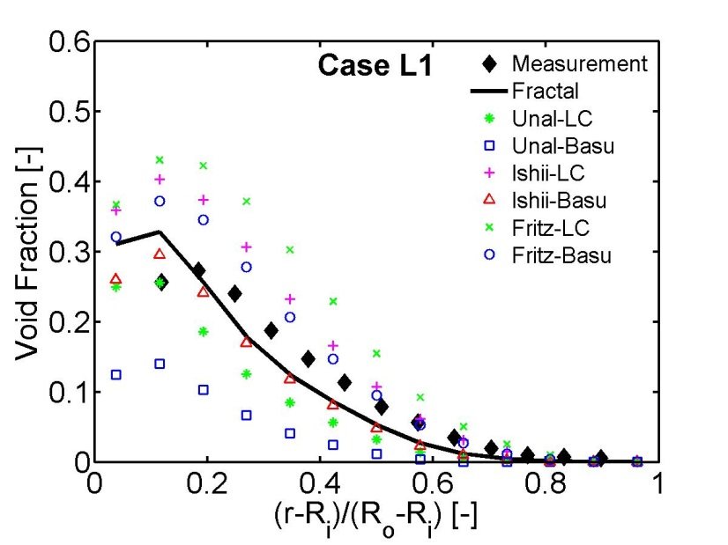
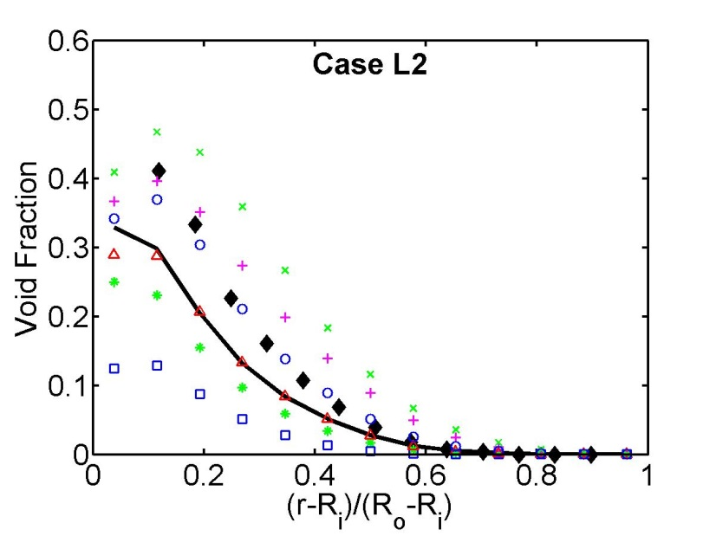
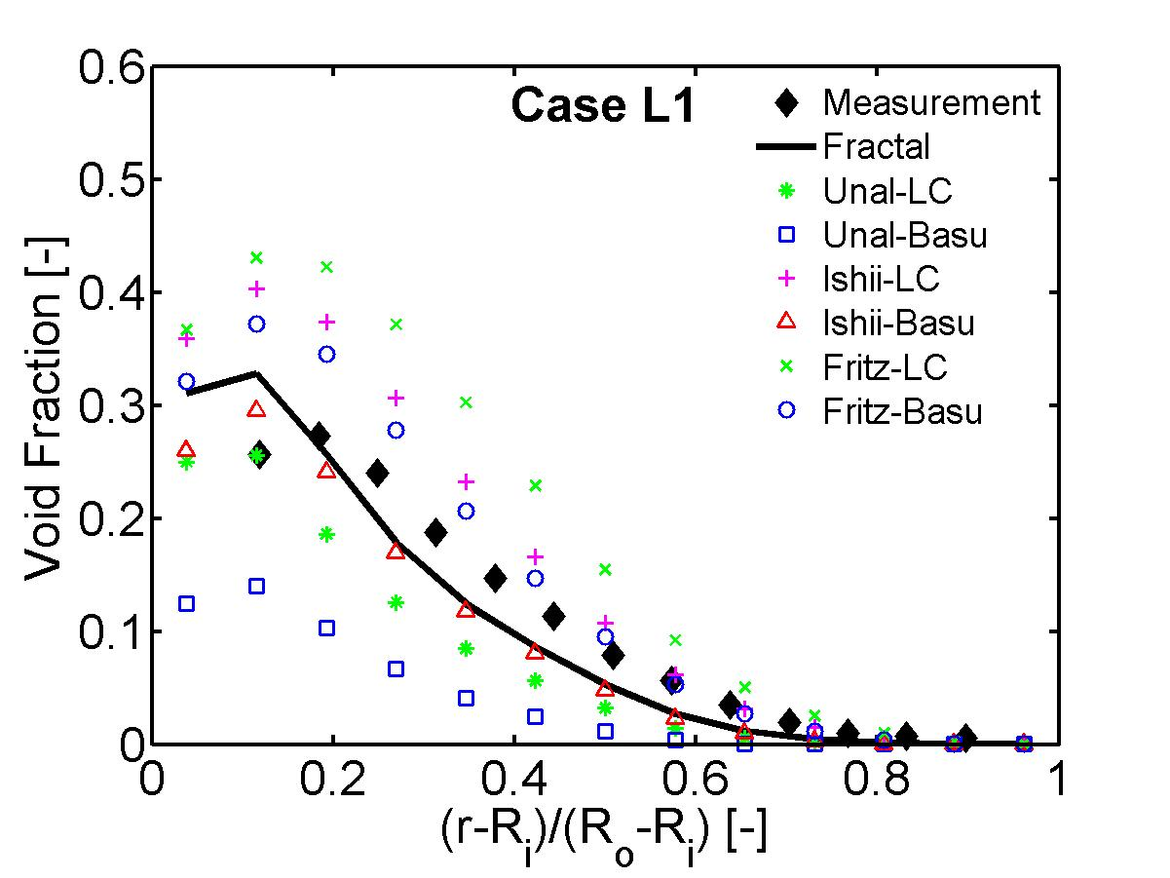
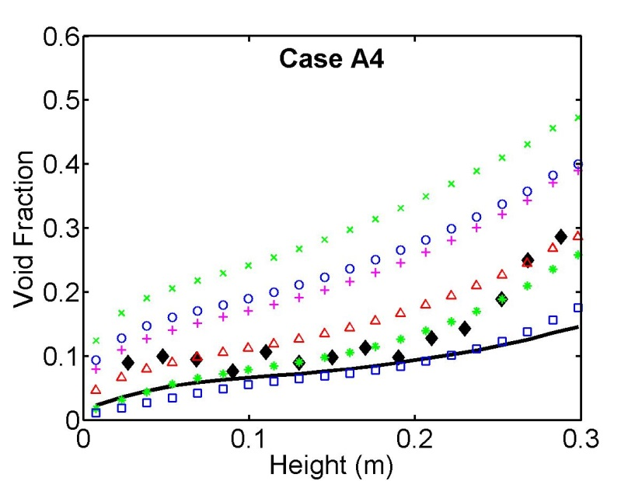
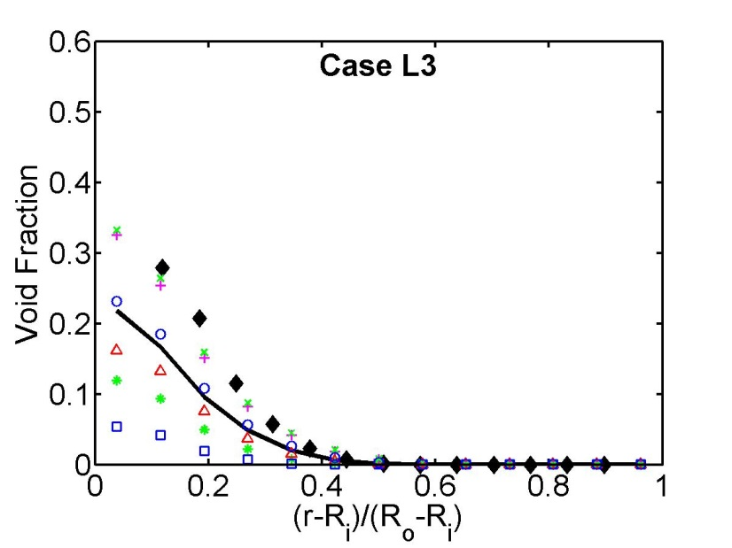
Void Fraction Distribution
higher void fraction close to the exit
Bubbles condense as get exposed to subcooled liquid
higher void fraction close to heated wall
Fig 7- G.H. Yeoh, S. Vahaji, S.C.P. Cheung and J.Y. Tu, Modelling Subcooled Flow Boiling in Vertical Channels at Low Pressures - Part 2: Evaluation of Mechanistic Approach, International Journal of Heat and Mass Transfer, Vol(75), pp. 754-768 (2014). Journal Rank: A*
Fig 8- G.H. Yeoh, S. Vahaji, S.C.P. Cheung and J.Y. Tu, Modelling Subcooled Flow Boiling in Vertical Channels at Low Pressures - Part 2: Evaluation of Mechanistic Approach, International Journal of Heat and Mass Transfer, Vol(75), pp. 754-768 (2014). Journal Rank: A*

Slide 45
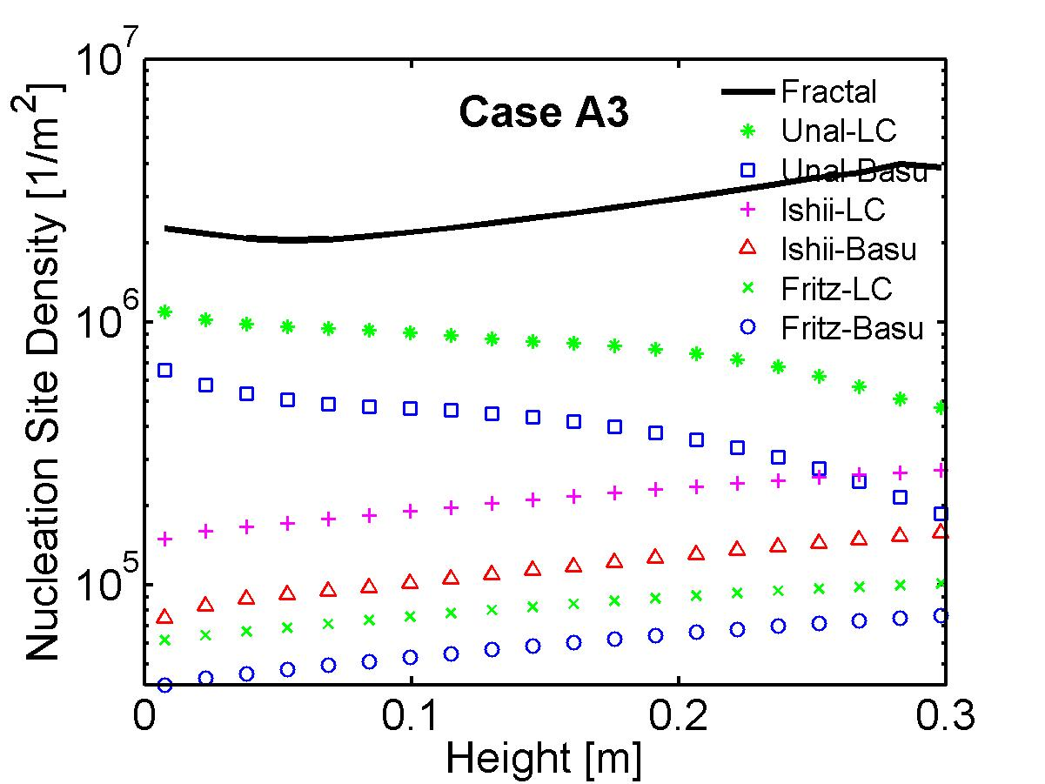
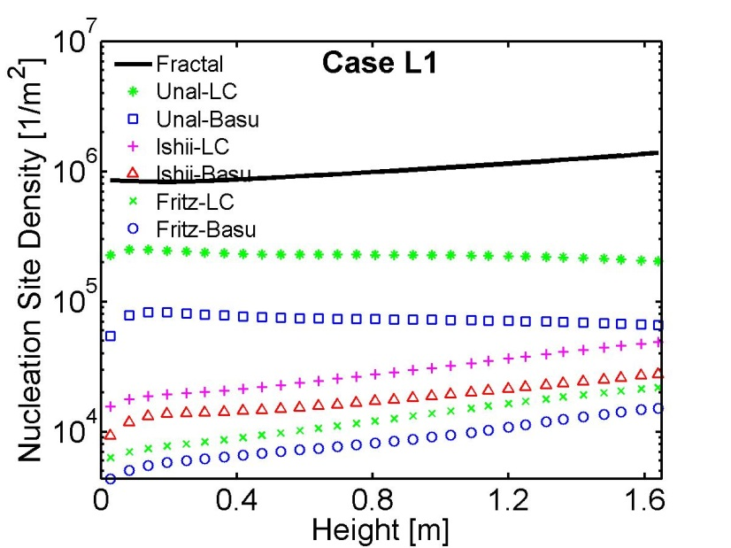
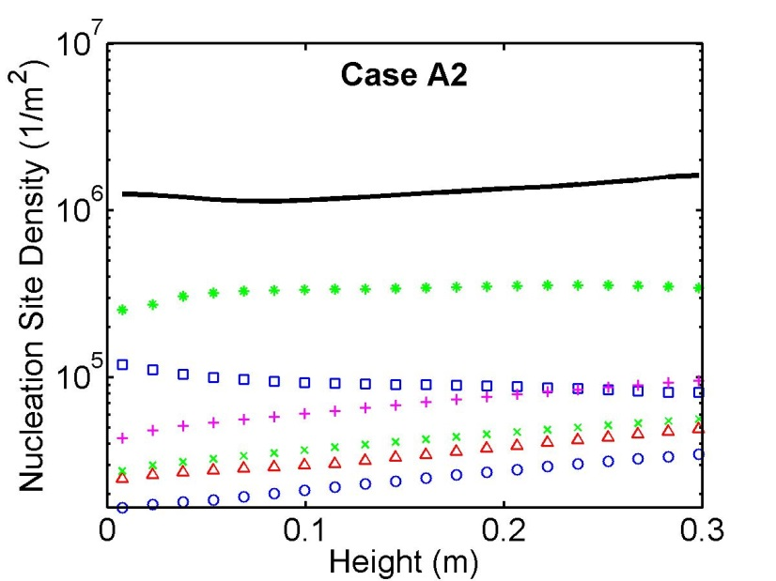
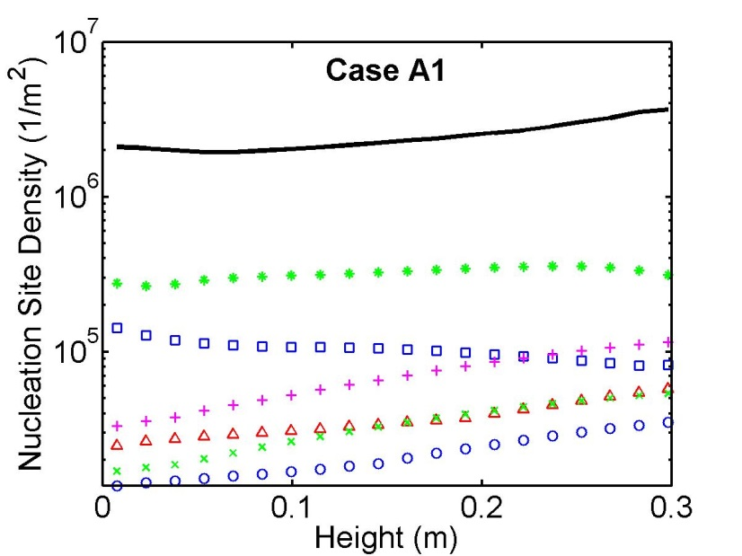
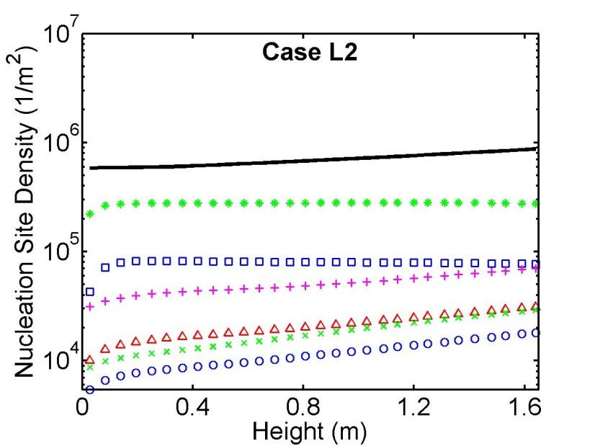
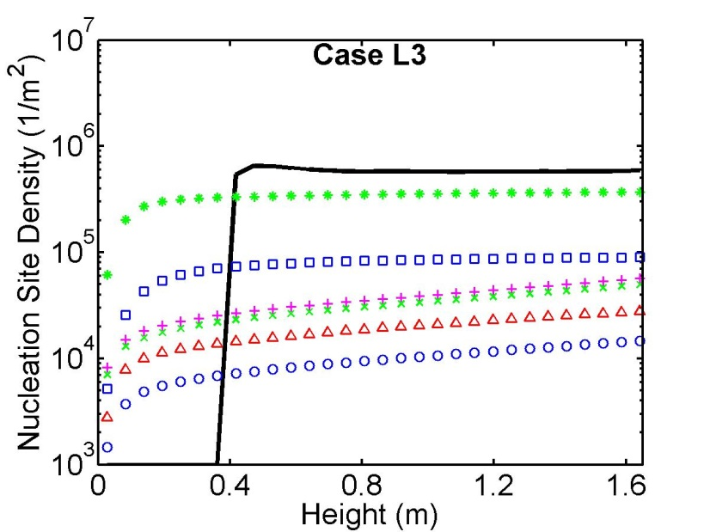
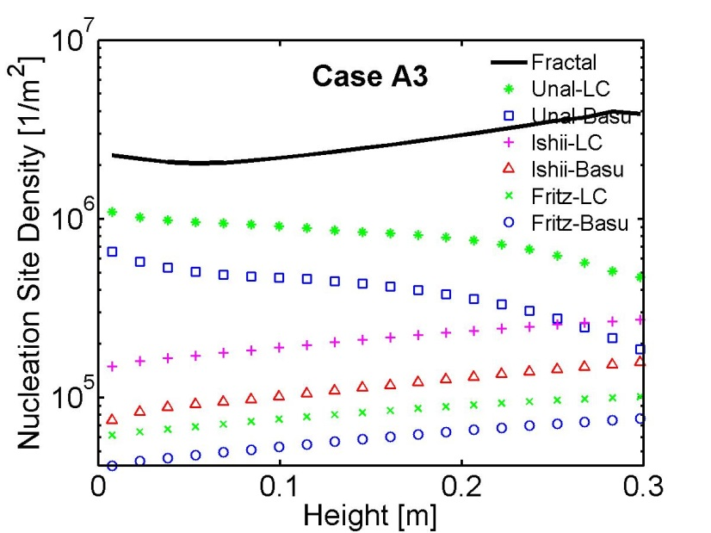
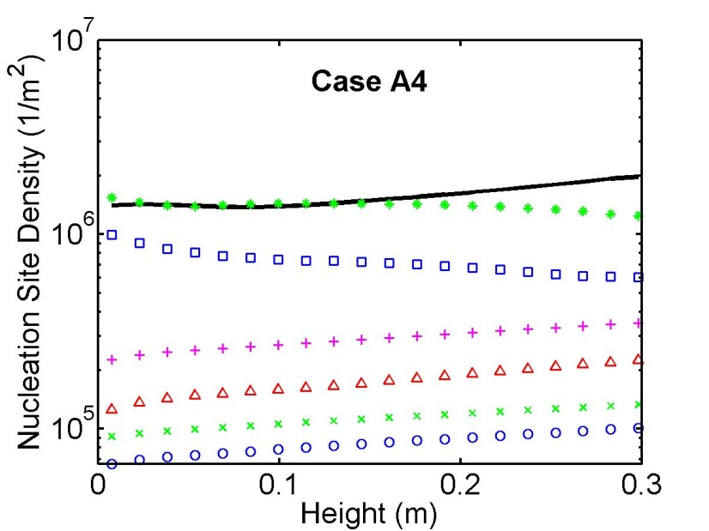
Nucleation site density distribution
Fig 4- G.H. Yeoh, S. Vahaji, S.C.P. Cheung and J.Y. Tu, Modelling Subcooled Flow Boiling in Vertical Channels at Low Pressures - Part 2: Evaluation of Mechanistic Approach, International Journal of Heat and Mass Transfer, Vol(75), pp. 754-768 (2014). Journal Rank: A*
Fig 3- G.H. Yeoh, S. Vahaji, S.C.P. Cheung and J.Y. Tu, Modelling Subcooled Flow Boiling in Vertical Channels at Low Pressures - Part 2: Evaluation of Mechanistic Approach, International Journal of Heat and Mass Transfer, Vol(75), pp. 754-768 (2014). Journal Rank: A*

Slide 46
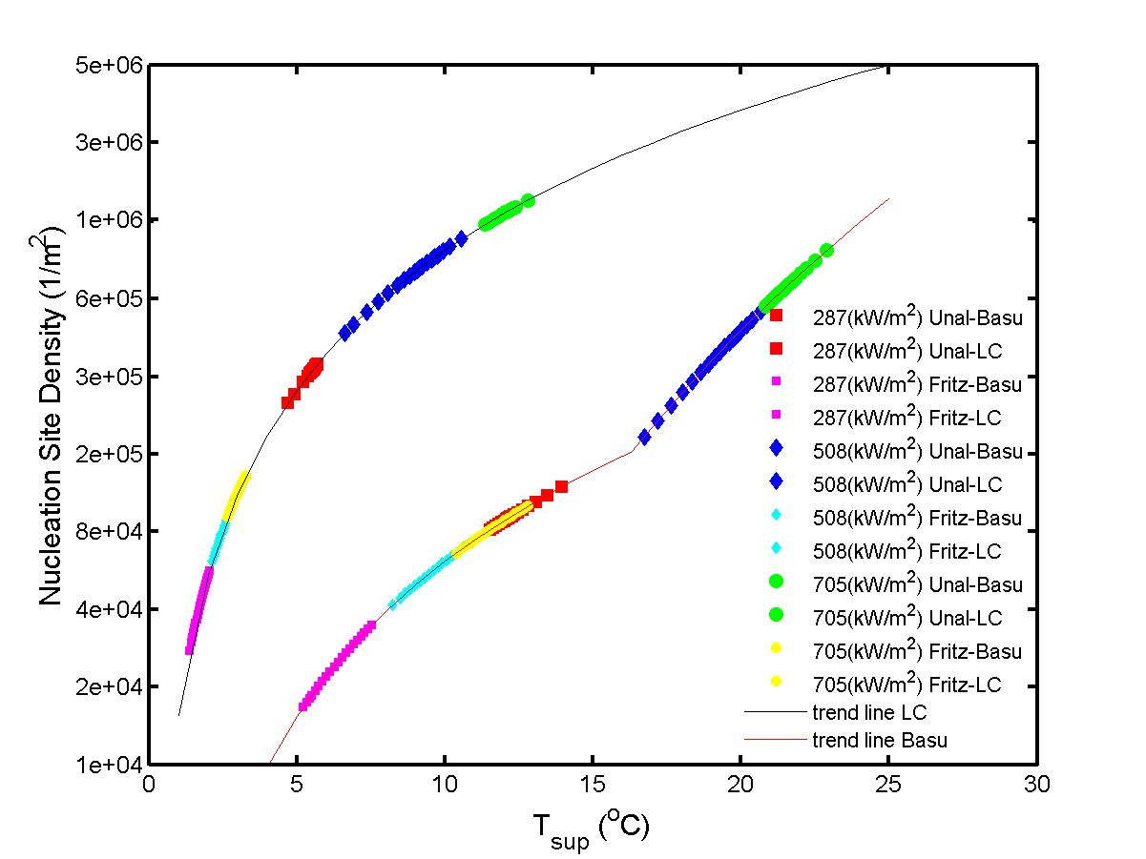
Nucleation Site Density vs. Superheat Temperature
LC predicts higher Na compared to Basu
Fig 12- G.H. Yeoh, S. Vahaji, S.C.P. Cheung and J.Y. Tu, Modelling Subcooled Flow Boiling in Vertical Channels at Low Pressures - Part 1: Evaluation of Mechanistic Approach, International Journal of Heat and Mass Transfer, Vol(75), pp. 736-753 (2014). Journal Rank: A*

Slide 47
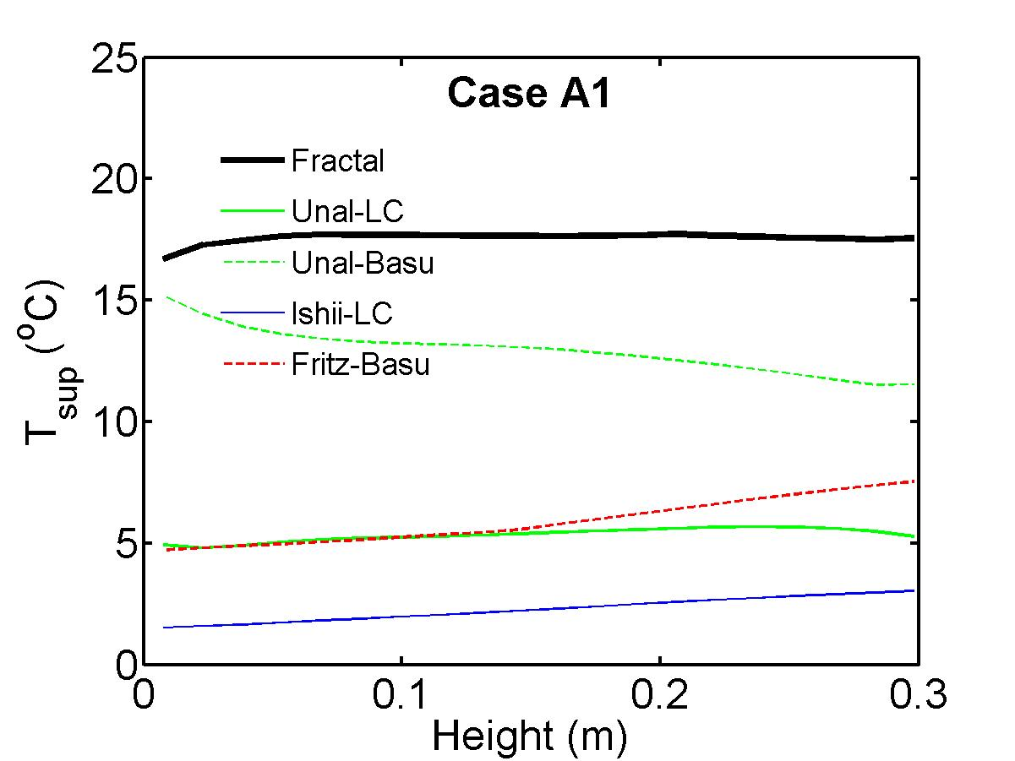
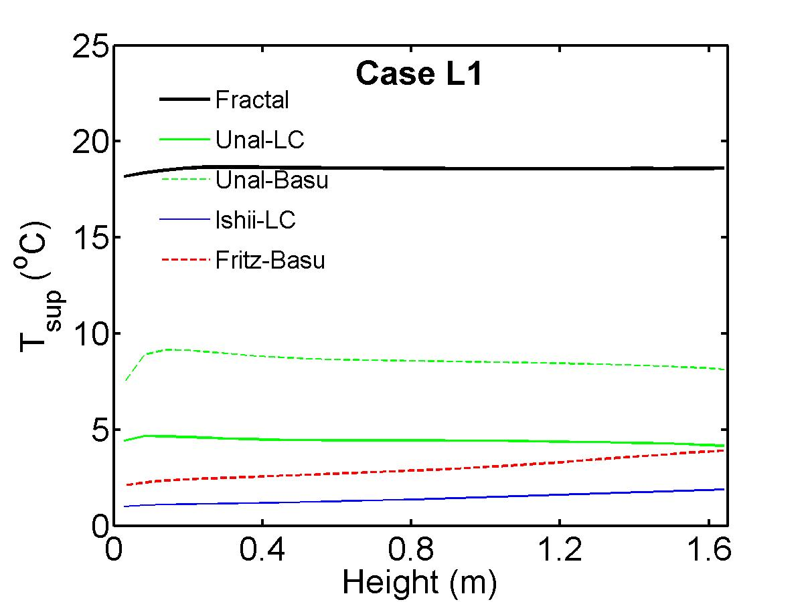
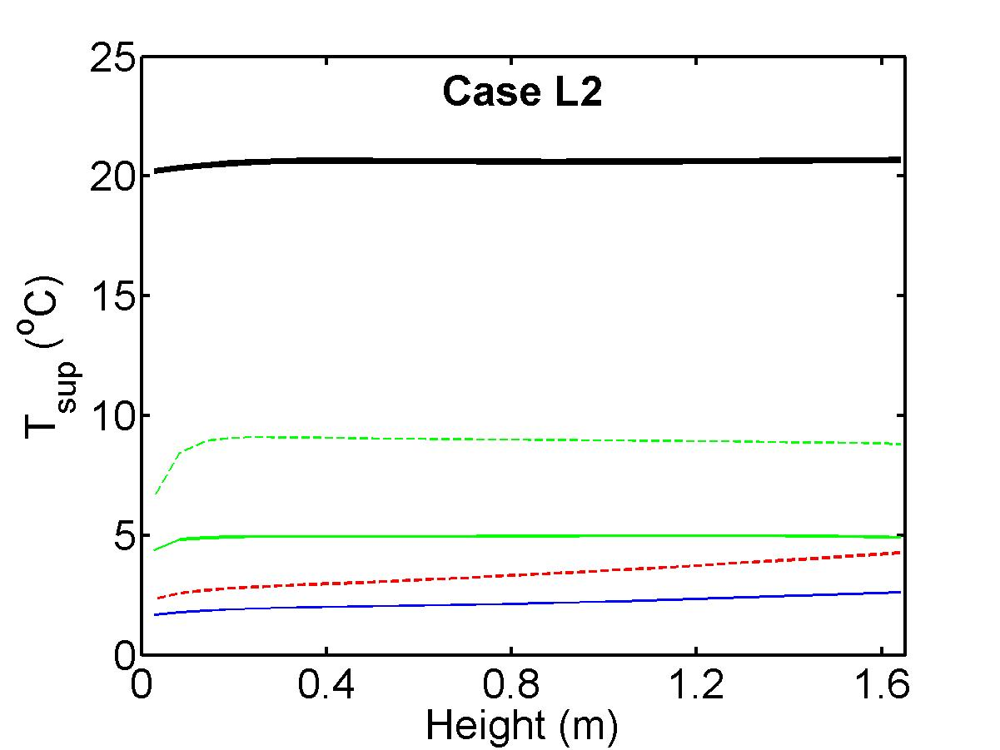
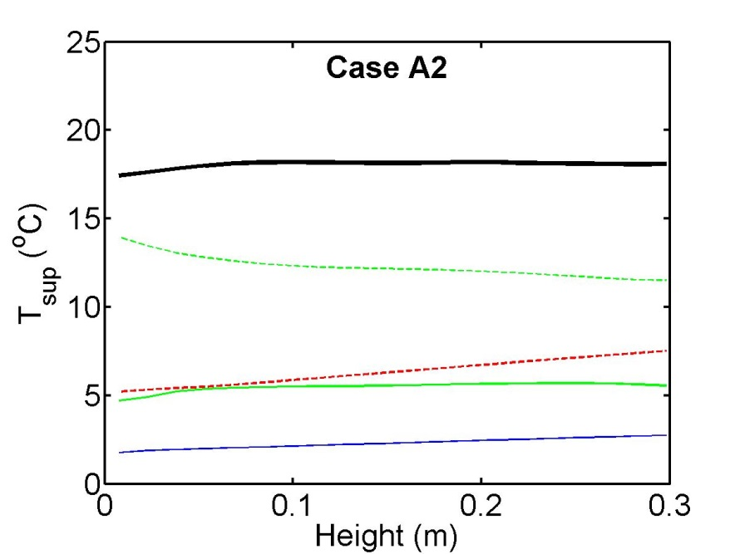
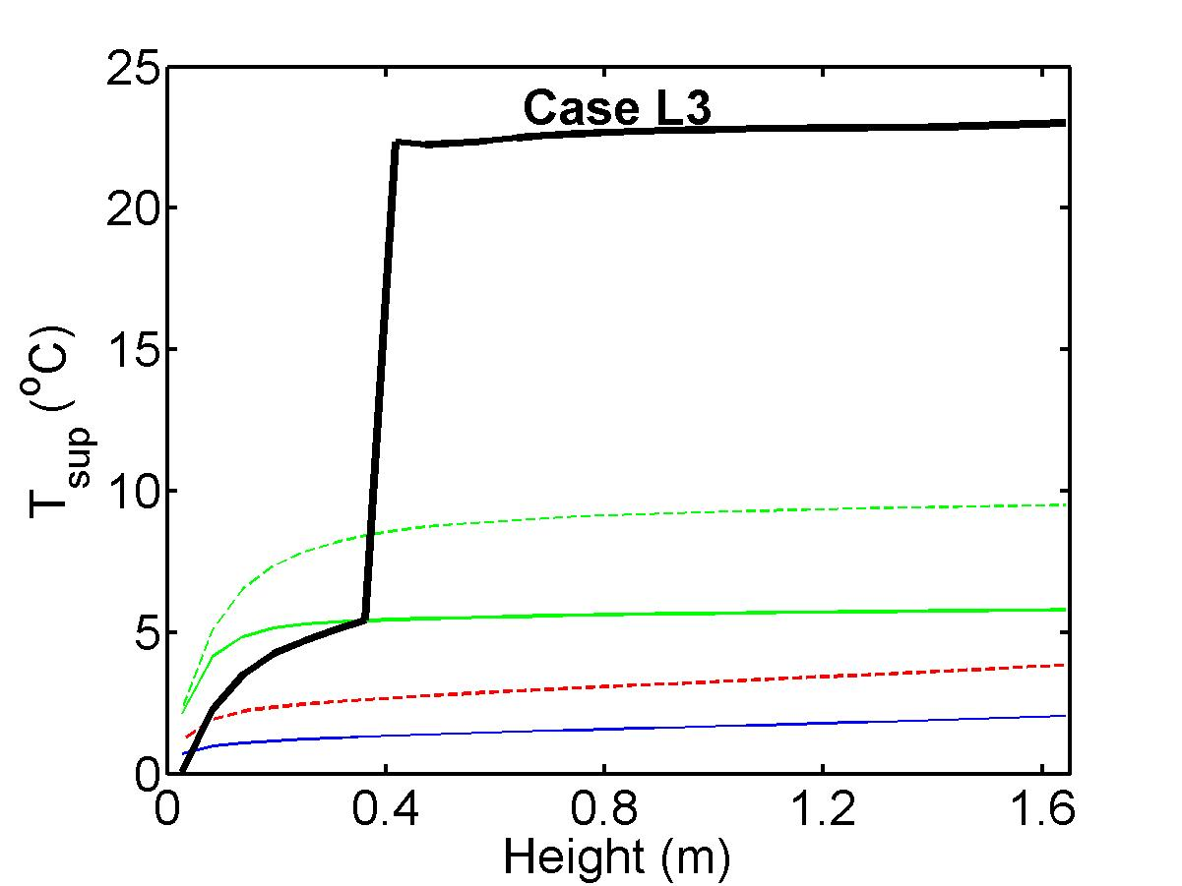
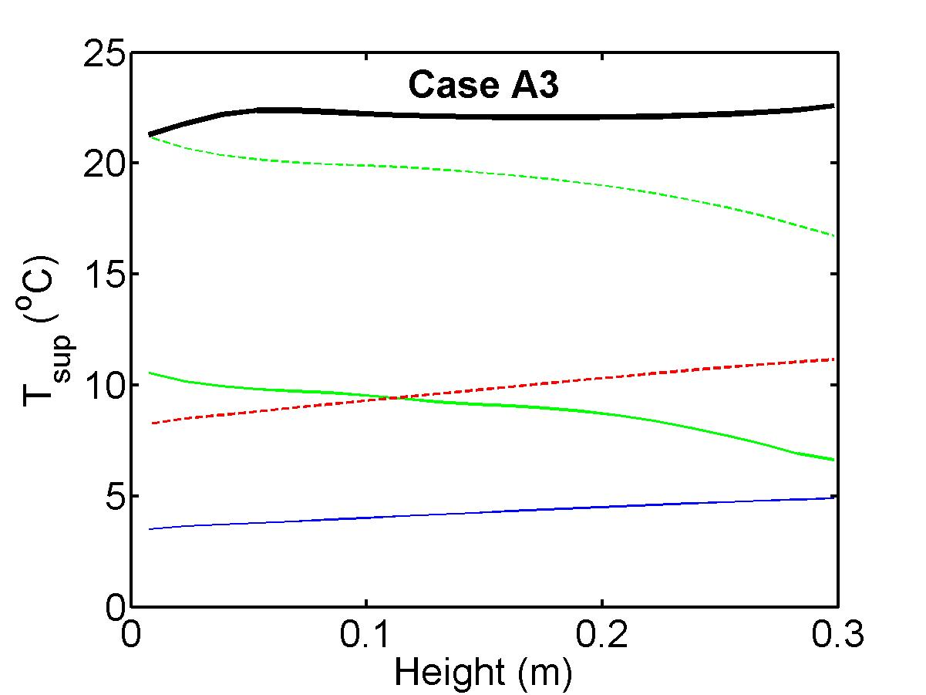
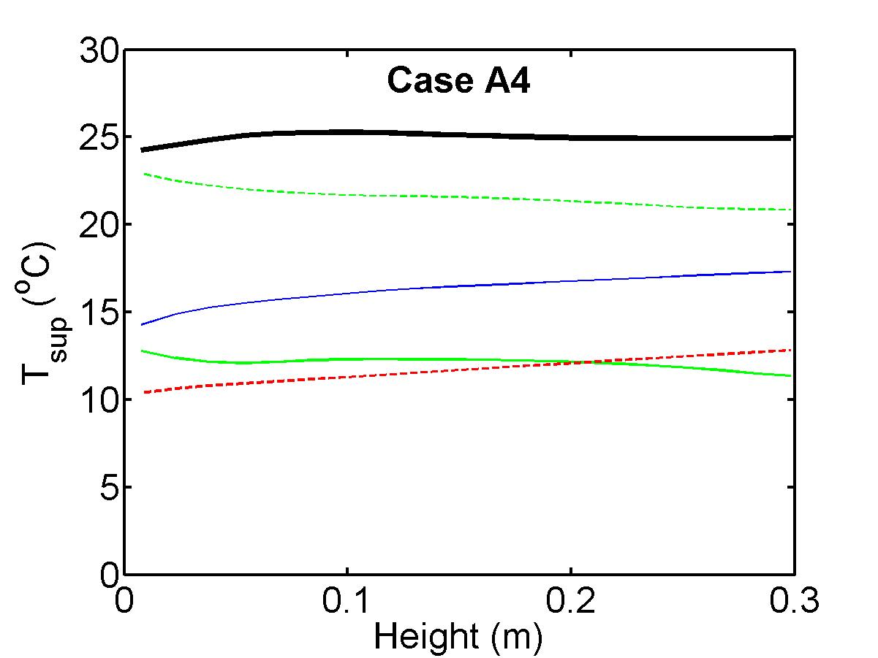
Wall superheat temperature
Fig 12- G.H. Yeoh, S. Vahaji, S.C.P. Cheung and J.Y. Tu, Modelling Subcooled Flow Boiling in Vertical Channels at Low Pressures - Part 2: Evaluation of Mechanistic Approach, International Journal of Heat and Mass Transfer, Vol(75), pp. 754-768 (2014). Journal Rank: A*
Fig 11- G.H. Yeoh, S. Vahaji, S.C.P. Cheung and J.Y. Tu, Modelling Subcooled Flow Boiling in Vertical Channels at Low Pressures - Part 2: Evaluation of Mechanistic Approach, International Journal of Heat and Mass Transfer, Vol(75), pp. 754-768 (2014). Journal Rank: A*

Slide 48
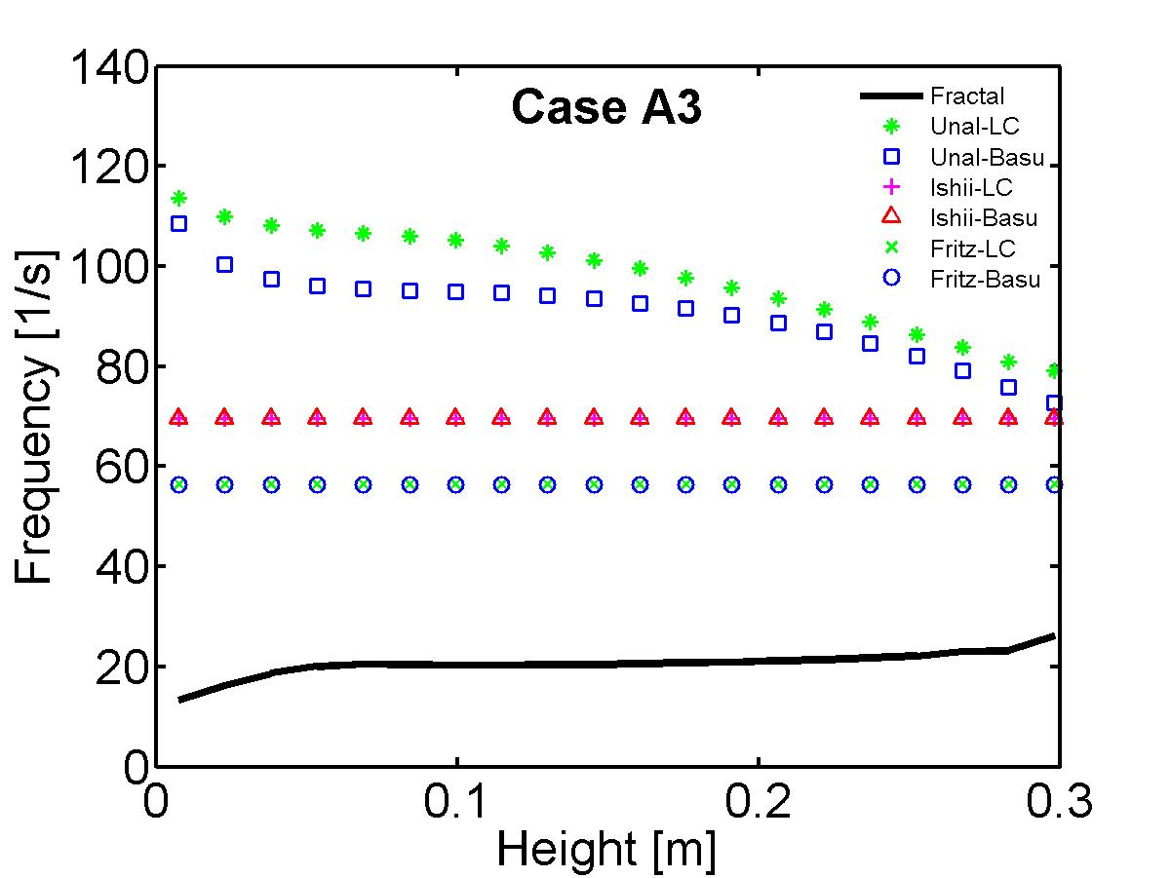
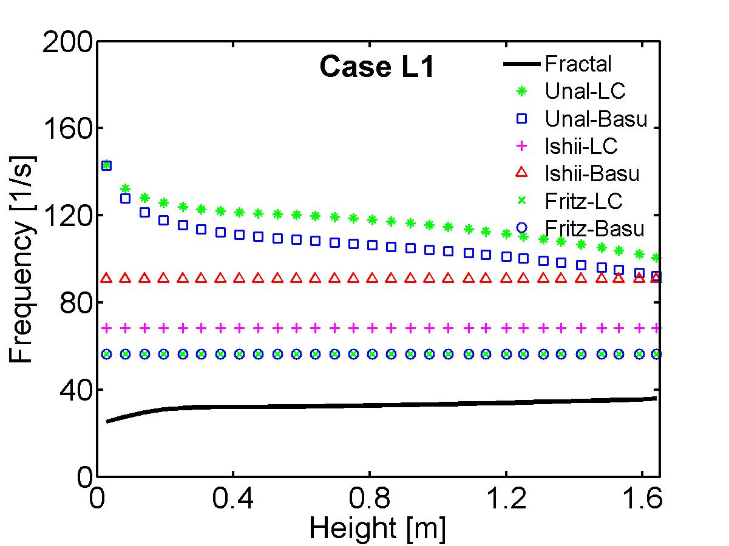
Bubble departure frequency
Increasing bubble frequency along the heated wall as expected from physical mechanisms

Slide 49
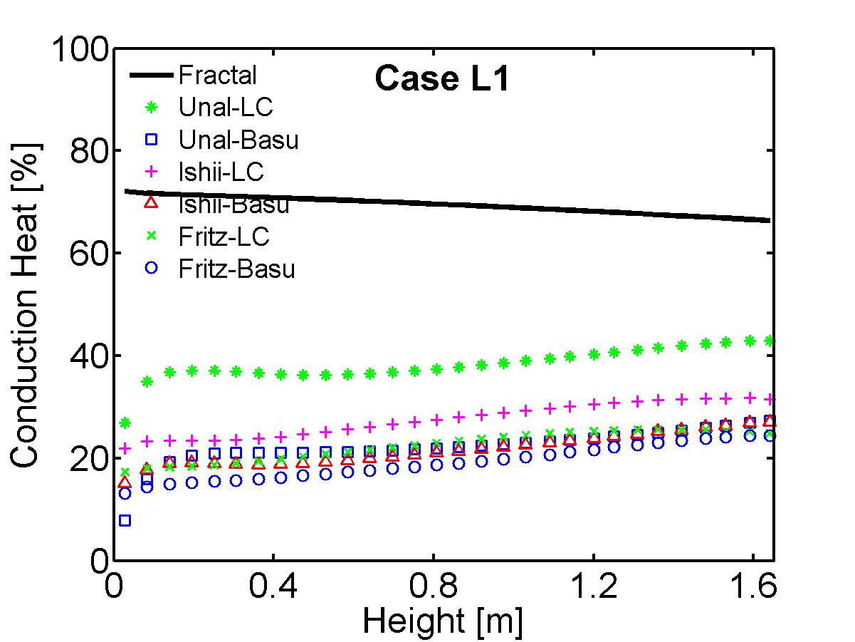








Contribution of conduction heat
High conduction due to sliding bubbles
Empirical correlations don’t pick enough quenching for radial case
Consistent prediction for both axial and radial cases
Fig 13- G.H. Yeoh, S. Vahaji, S.C.P. Cheung and J.Y. Tu, Modelling Subcooled Flow Boiling in Vertical Channels at Low Pressures - Part 2: Evaluation of Mechanistic Approach, International Journal of Heat and Mass Transfer, Vol(75), pp. 754-768 (2014). Journal Rank: A*
Fig 14- G.H. Yeoh, S. Vahaji, S.C.P. Cheung and J.Y. Tu, Modelling Subcooled Flow Boiling in Vertical Channels at Low Pressures - Part 2: Evaluation of Mechanistic Approach, International Journal of Heat and Mass Transfer, Vol(75), pp. 754-768 (2014). Journal Rank: A*

Slide 50
Case study II: subcooled boiling at elevated pressure
Exp. by Ozar et al.
38.1 mm
19.1 mm
1.7 m long
Non-Heated Section
Experimental conditions
Heated Inner Tube
Case | P_{inlet} [MPa] | T_{inlet} [ºC] | T_{sub} (inlet) [ºC] | Q_{w} [kW/m²] | G [kg/m²s]
M1 | 0.218 | 110.3 | 12.7 | 237.9 | 1843.8
M2 | 0.497 | 136.7 | 14.8 | 190.9 | 942.3
M3 | 0.949 | 167.6 | 10.0 | 208.5 | 964.4
Measuring Plane
at
2.05 m
2.8 m long Heated Section
Inlet Liquid Flow

Slide 51
Radial Void Fraction Distribution at 2.05m

Slide 53
Influence of pressure – empirical model

Slide 54
Influence of pressure – mechanistic model

Slide 55
Conclusion
A more mechanistic approach for bubble frequency, departure and lift-off diameter, and active nucleation site density is presented
Some empirical correlations yield better prediction with axial condition but are not good for local condition
The mechanistic model is capable of capturing underlying physics
Transient conduction due to sliding bubbles becomes the dominant heat transfer mode
Mechanistic model could cover a wide range of fluid conditions consisting of wall heat flux, inlet velocity, inlet subcooling temperature, and pressure

Slide 56
Future work
Other fluids
A more mechanistic approach for prediction of bubble growth rate in force balance model
More precise model for better handling bubble induced turbulence
Packing behavior of neighbouring bubbles
Different coalescence and break-up kernels

Slide 57
Acknowledgement:
ARC Linkage Project (LP0990691) and Green Earth Energy Ltd.
ARC Discovery Project (DP130100819)
Defence Science and Technology Organisation (DSTO)

Slide 58
All Publications:
Refereed Journal Articles:
S. Vahaji, S.C.P. Cheung, G.H. Yeoh and J.Y. Tu, Investigation of the Influence of Elevated Pressure on Subcooled Boiling Flow - Evaluation of Mechanistic Approach, AIChE Journal, (Under Review) (2015). Journal Rank: A*
A. Date, S. Vahaji, J. Andrews and A. Akbarzadeh, Experimental performance of a rotating two-phase reaction turbine, Applied Thermal Engineering, Vol. 76, pp. 475-483 (2015). Journal Rank: A*
G.H. Yeoh, S. Vahaji, S.C.P. Cheung and J.Y. Tu, Modelling Subcooled Flow Boiling in Vertical Channels at Low Pressures - Part 2: Evaluation of Mechanistic Approach, International Journal of Heat and Mass Transfer, Vol(75), pp. 754-768 (2014). Journal Rank: A*
S.C.P. Cheung, S. Vahaji, G.H. Yeoh and J.Y. Tu, Modelling Subcooled Flow Boiling in Vertical Channels at Low Pressures - Part 1: Assessment of empirical correlations, International Journal of Heat and Mass Transfer, Vol(75), pp. 736-753 (2014). Journal Rank: A*
S. Vahaji, A. Akbarzadeh, A. Date, S.C.P. Cheung and J.Y. Tu, Efficiency of a two-phase nozzle for geothermal power generation, Applied Thermal Engineering, Vol. 73, pp. 227-235 (2014). Journal Rank: A*
S. Vahaji, A. Date, S.C.P. Cheung, J.Y. Tu, A. Akbarzadeh and M. Oreijah, Experimental analysis of two-phase flow nozzle for desalination and power generation system, Proceedia Engineering, Vol. 49, pp. 324-329 (2012).
Refereed Conference Papers:
S. Vahaji, L. Chen, S.C.P. Cheung and J.Y. Tu, Modelling of Two-Phase Bubbly Flow over a Flat Plate, 19th Australasian Fluid Mechanics Conference, Melbourne, Australia, Paper No. 55 (Dec. 2014).
S. Vahaji, S.C.P. Cheung, G.H. Yeoh and J.Y. Tu, Modeling Subcooled Boiling Flow in Low and Medium Pressures – Evaluation of Mechanistic Approach, OECD/NEA & IAEA Workshop, CFD4NRS-5, Application of CFD/CMFD Codes to Nuclear Reactor Safety and Design and their Experimental Validation, Zurich, Switzerland (Sep. 2014).
S. Vahaji, A. Akbarzadeh, A. Date, S.C.P. Cheung and J.Y. Tu, The efficiency of a two-phase nozzle as a motive force for power generation from low temperature resources, Heat Transfer 2014, A Coruna, Spain, Vol. 83 of WIT Transactions on Engineering Sciences, (Jul 2014).
S. Vahaji, S.C.P. Cheung, G.H. Yeoh and J.Y. Tu, Towards a mechanistic model for subcooled flow boiling at low pressure, CFD 2014, Trondheim, Norway, Paper No. 045 (Jun 2014).

Slide 59
THANK YOU

Slide 60


Slide 61
Breakage Mechanism
Breakage due to the impact of turbulent eddies
Uneven breakage due to fluid shearing
Impact by turbulent eddies
Even breakage
Unaffected

Slide 62


Bubble Size Distribution – break-up coefficient = 0.05
Case Q1-V9.6
Q_{a}
Bubble size
Case Q3-V9.6
Fig 4- S. Vahaji, L. Chen, S.C.P. Cheung and J.Y. Tu, Modelling of Two-Phase Bubbly Flow over a Flat Plate, 19th Australasian Fluid Mechanics Conference, Melbourne, Australia, Paper No. 55 (Dec. 2014).

Slide 63

Wall Heat Flux Partition Flowchart
Fig 2 G.H. Yeoh, S. Vahaji, S.C.P. Cheung and J.Y. Tu, Modelling Subcooled Flow Boiling in Vertical Channels at Low Pressures - Part 2: Evaluation of Mechanistic Approach, International Journal of Heat and Mass Transfer, Vol(75), pp. 754-768 (2014). Journal Rank: A*

Slide 64
Transient Conduction
Fractal model for stationary bubbles
Fractal model for sliding bubbles
Waiting time
Departure diameter
Average diameter (D_{d} +D_{l})/2 where D_{l} is the lift-off diameter
Sliding time

Slide 65
Other Wall Heat Flux Components
Fractal model for evaporation
Fractal model for convection
Reduction factor – ratio of actual number of bubbles lifting off to the number of active nucleation sites
Lift-off diameter
Area of influence
d = 2 for 2D space

Slide 66
Results and Discussion
Local comparison
Local measurements at 1.61 m downstream of the beginning of the heated section (near the flow exit)
Homogeneous Multiple Size Group (MUSIG) model
15 classes between 0 mm and 8.5 mm

Slide 67
Results and Discussion (con’t)
Axial comparison
Axial measurements
Homogeneous Multiple Size Group (MUSIG) model
15 classes between 0 mm and 6.0 mm

Slide 68
Results and Discussion
Elevated pressure comparison
Local measurement 2.05 m downstream of the beginning of the heated section
Homogeneous Multiple Size Group (MUSIG) model
15 classes between 0 mm and 6.35 mm

Slide 69


Frequency distribution
Fig 6 G.H. Yeoh, S. Vahaji, S.C.P. Cheung and J.Y. Tu, Modelling Subcooled Flow Boiling in Vertical Channels at Low Pressures - Part 2: Evaluation of Mechanistic Approach, International Journal of Heat and Mass Transfer, Vol(75), pp. 754-768 (2014). Journal Rank: A*

Slide 70




Frequency distribution
Fig 5 G.H. Yeoh, S. Vahaji, S.C.P. Cheung and J.Y. Tu, Modelling Subcooled Flow Boiling in Vertical Channels at Low Pressures - Part 2: Evaluation of Mechanistic Approach, International Journal of Heat and Mass Transfer, Vol(75), pp. 754-768 (2014). Journal Rank: A*

Slide 72
Radial Interfacial Area Concentration Distribution at 2.05m

Slide 73
Radial Bubble Sauter Mean Diameter Distribution at 2.05m

Slide 74
Transient Conduction
Heat transfer due to sliding and stationary bubbles:
latent heat transfer due to microlayer evaporation
transient conduction during the waiting period
Stationary bubble: point of inception
Sliding bubble: area occupied by the sliding bubble at any instant of time and regions being swept by sliding bubbles

Slide 75
Fractal Model (con’t)
Formulation:
df for a boiling system:
Averaged over maximum active cavities
Constant value = 0.1ºC

Slide 76

Three-dimensional Two-Fluid Model
Continuity Equation:
Liquid Phase
Gas Phase

Slide 77
Three-dimensional Two-Fluid Model (con’t)
Momentum Equation:
Interphase Momentum Transfer
where

Slide 78
Three-dimensional Two-Fluid Model (con’t)
Energy Equation:
Interphase Heat Transfer
where
Interfacial heat transfer
Sauter Mean Diameter

Slide 79





Axial bubble Sauter mean diameter distribution
Bigger bubble size close to the exit

Slide 80




Radial bubble Sauter mean diameter distribution
bigger size close to heated wall due to coalescence
Bubbles condense as get exposed to subcooled liquid

Slide 81
Influence of pressure on Na and f

